Slide 1

AirBnb New Destination prediction
Kaggle competition

Slide 2

Predicting destination with given feature
Airbnb wants to predict where new user likely to book their first travel experience. Depend on their age, gender, and many other personal preferences, each customer will have a difference in choosing their first destination. Through accurate data analysis, the company will be able to provide a shorter time to find a destination and better-personalized contents for the first users.
Your company name

Slide 3
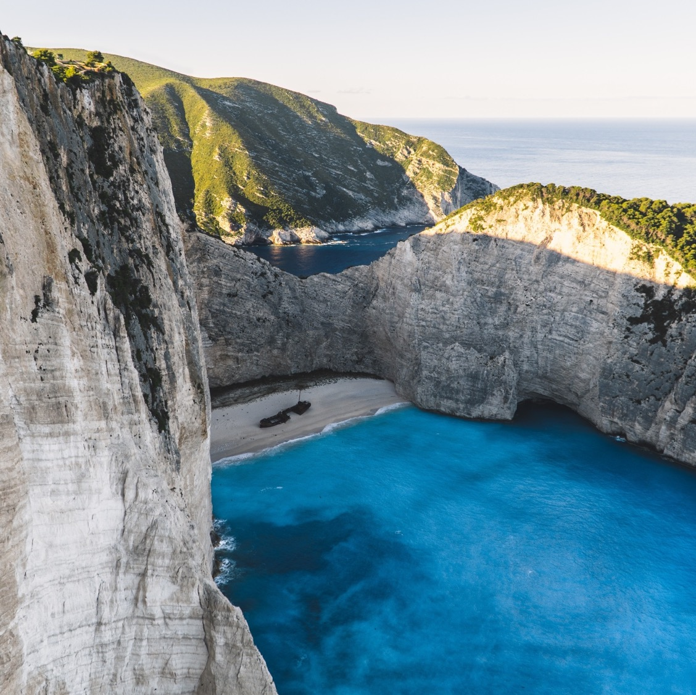
Data
Train : Airbnb users info includes their destination.
Test : Data given to predict country destination based on train set
Session :supplementary data
Your company name

Slide 4
Gender
The most of users selected US as their first destination
there were more female booker or equal amount in gende
there is difference in gender in country selection such as in Canada and Denmark
gender may considered to be significant variable that effect the country destination.
Your company name

Slide 5
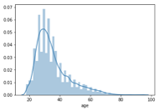
Age
age between 20 and 40 has highest amount of users
there are large amount of user until 60s in most of countries
while GB is more selected than ES in country destination, the ES has wider age range than GB
Therefore, the age could be considered as import variable that effect country destination.
Your company name

Slide 6
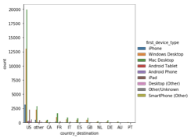
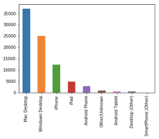
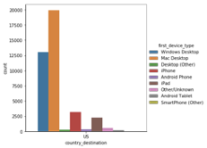
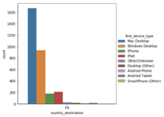
First device type
the mac and window desktop were used most
all of the countries the mac desktop were used most then the window desktop were used
n US, while iphone were 3rd most used device, in France, the ipad were used more than iphone
This could be considered as important variable for the country destination.
Your company name

Slide 7
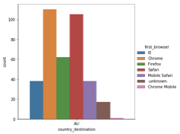
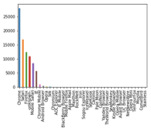
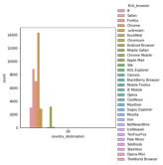
First browser
chrome , safari and firefox were used repectively there are large amount of user until 60s in most of countries
, while there were a lot of the browser in US, about 31 kind of browser, there were only 7 browser were used in the Australia
Therefore, the age could be considered as import variable that effect country destination.
Your company name

Slide 8
Second elapsed
For the variable second_elapsed the user selected Denmark took more seconds than the user selected France and Italia
Your company name

Slide 9
Unused features
Signup method
basic and facebook was selected for most of the users
pattern matches in all the countries
Signup app
all the countries revealed same pattern.
The web was used most then ios was selected next
language
English was most used language more than 90%
Your company name

Slide 10
Correlation table
the correlation color graph was plotted to identify the variable has relationship with country destination.
it was hard to tell the color of the plot and identify which of the variable has correlation with country destination.
they are slightly correlated or likely to be uncorrelated.
it could be significant in the presence of other variables in the multivariate model.
Your company name

Slide 11
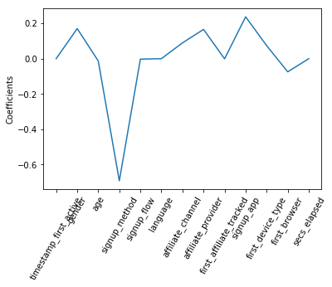
Feature selection
Feature selection using Lasso regression plot
the number of features used were identified to be 9 features
important 9 features are identified to be gender, age, signup method, affiliate channel, affiliate provider, first affiliated tracked, signup app, first device type, first browser
Your company name

Slide 12
Machine learning
Logistic regression | SVM (Supprt Vector Machine) | XGboost
micro avg 0.71 macro avg 0.09 weighted avg 0.51 | train set accuracy SVM: 0.78
Accuracy score : 0.71 | Test Accuracy score : 0.71 | Accuracy: 56.57%
Your company name

Slide 13

Thank You
Irenee.jy93@gmail.com
https://github.com/Irenejy93/Airbnb

